Slide 1
Notes:
What are some characteristics of data?

Slide 2
About Data
What is data?
Is it different from information?
What’s the difference between data and metadata?
What does data look like?
Notes:
Metadata: “Metadata are "data [information] that provide information about other data". (Wikipedia, “Metadata”)

Slide 3
Attributes of data
Shareable: Readily accessed by more than one person at a time
Transportable: Easily moved to a decision maker
Secure: Protected from destruction and unauthorized use
Accurate: Reliable, precise records
Timely: Current and up-to-date Relevant Appropriate to the decision
Watson, Richard (2013-12-27). Data Management . eGreen Press.

Slide 4
Attributes of Data
Usability
Relevant
Simple
Flexible
Economical
Delivery
Timely
Accessible
Secure
Quality
Accurate
Verifiable
Complete
Reliable

Slide 5
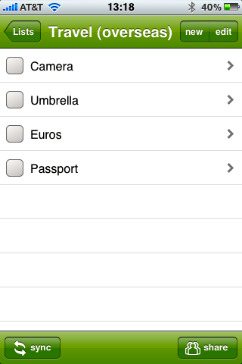
An Example of Data
Structure
Easily scanned
Nested

Slide 6
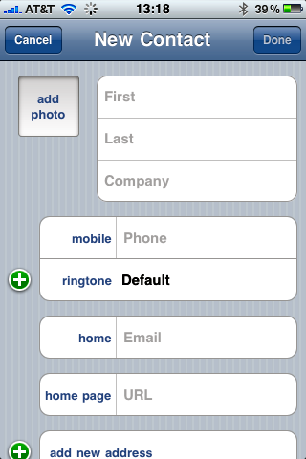
An Example of Data
Structured
Pre-formatted space
Null-able fields
Metadata
Implicit ordering

Slide 7
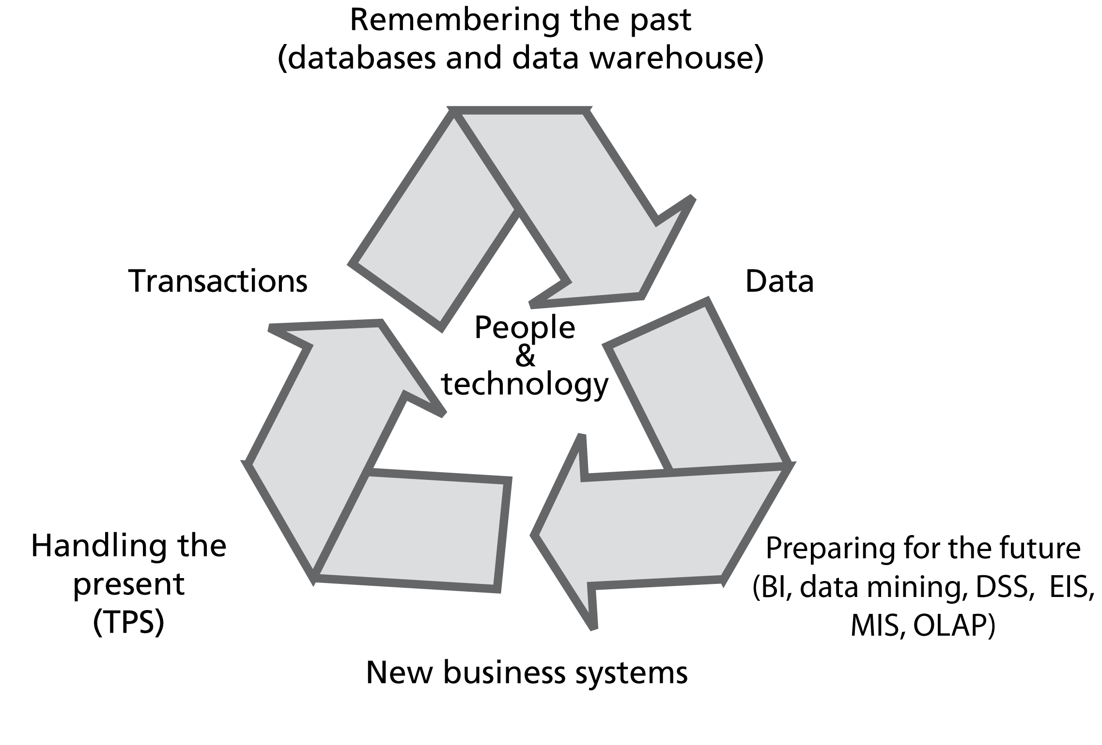
The Information Systems Cycle
Watson, Richard (2013-12-27). Data Management . eGreen Press.

Slide 8
Tradeoffs in Storing Data
CAP Theorem (also called Brewster’s Theorem)
At best, a distributed system can provide only two of the three guarantees:
Consistency All nodes see the same data at the same time)
Availability Every request receives a response about whether it succeeded or failed
Partition tolerance System continues to operate despite arbitrary partitioning due to network failures

Slide 9
Continuum of Storage Tradeoffs
RAM
Solid State
Magnetic Disk
SAN
Tape
Notes:
Speed — Cost

Slide 10
Problems with Data Management Systems
Lack of redundancy
Lack of data control
Poor interface
Lack of access/lack of security
Delays
Lack of reality
Diversity of systems/silos
Lack of data integration
Volume of data
Notes:
Data silos are revealed as an organization grows.
Data should have a documented owner. Other documentation should include meaning, associated risk/security, strategic importance, etc.

Slide 11
So, what?
We’ll come back to these issues
Use them as points to consider in your cases and other modules.
In development, we mostly set these concerns aside, and focus on building applications to access data.
However, project owners should have a plan for the deployment of data systems.
Who will own the data?
How will it be current?
How can we integrate it with the organization's other systems?

Slide 12
API
Photo: Simone Berettoni
Notes:
Photo: Simone Berettoni, via Flikr (CC-BY-NC-ND) https://www.flickr.com/photos/berettoni/3515319579/

Slide 13
API—Application Programming Interface
The way to connect to applications or data
How applications talk to each other
May be public or private
“API” used to describe both the specification and the service
See also “What APIs Are and Why They’re Important”, HACK, 2013

Slide 14
Random User API
https://randomuser.me
Try with different data formats:
JSON: https://randomuser.me/api/
XML: https://randomuser.me/api/?format=xml
YAML: https://randomuser.me/api/?format=yaml
CSV: https://randomuser.me/api/?format=csv

Slide 15
XML—eXtensible Markup Language
Uses tags (also called elements) and attributes
<name>John</name>
OR
<person id="John">…</person>
Has only one root node
Typically, tags are used for data, and attributes for metadata

Slide 16
JSON—JavaScript Object Notation
Described at http://json.org
Text form of a valid Javascript object
{
"key": "Value",
"array": [1,2,3],
"object": { "anotherKey": "value"}
}

Slide 17
Compare XML and JSON
XML
JSON
<employees>
<employee>
<firstName>John</firstName>
<lastName>Doe</lastName>
</employee>
<employee>
<firstName>Anna</firstName> <lastName>Smith</lastName>
</employee>
<employee>
<firstName>Peter</firstName> <lastName>Jones</lastName>
</employee>
</employees>
{
"employees":
[
{
"firstName":"John",
"lastName":"Doe”
},
{
"firstName":"Anna",
"lastName":"Smith”
},
{
"firstName":"Peter",
"lastName":"Jones”
}
]
}

Slide 18
Explore public APIs
https://github.com/toddmotto/public-apis

